Slide 1
Data Analysis using Hadoop and Hive
Optimizing Hive by using Partitioning and Bucketing
Soham Chakraborty
2276590

Slide 2
Problem Statement
We have an eCommerce company that maintains sales data, including information such as invoice ID, stock code, quantity, item description, customer ID, country, and invoice date. The table is used for various analytical queries to gain insights into sales trends, customer behavior, and inventory management.
However, as the volume of data in the table will grow, query performance will become a concern. We need to optimize the table's structure and storage to improve query performance, particularly for commonly used filtering and aggregation operations.

Slide 3
Introduction
Apache Hive is a powerful data warehouse infrastructure built on top of Hadoop that provides an interface for querying and analyzing large datasets stored in Hadoop's distributed file system (HDFS). It enables users to query data using a SQL-like language called HiveQL, making it accessible to those familiar with SQL.
Partitioning involves dividing data into smaller, more manageable subsets based on specific columns. This helps in improving query performance by allowing Hive to prune irrelevant partitions based on query predicates, thereby reducing the amount of data scanned during query execution.
Bucketing involves grouping data into a fixed number of buckets based on the hash value of a column. This helps in evenly distributing data and improving query performance for certain types of queries, especially joins and aggregations.

Slide 4
Technology used
Hadoop Ecosystem
Linux - Unix
Apache Hive: Data warehouse infrastructure
built on top of Hadoop for querying and
analyzing large datasets.
HDFS: Distributed file system for storing large datasets.

Slide 5
Setting up the Hadoop Environment and making sure that all the daemons are running . Bringing the Online Retail dataset into HDFS Creating a hive table and storing the data from the HDFS to the hive table
Implementation

Slide 6
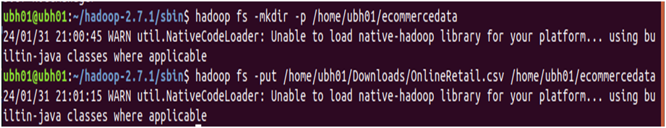
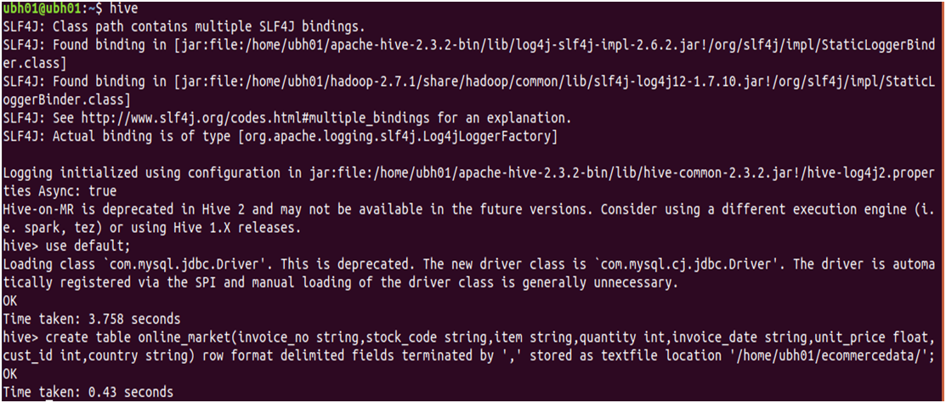

Slide 7
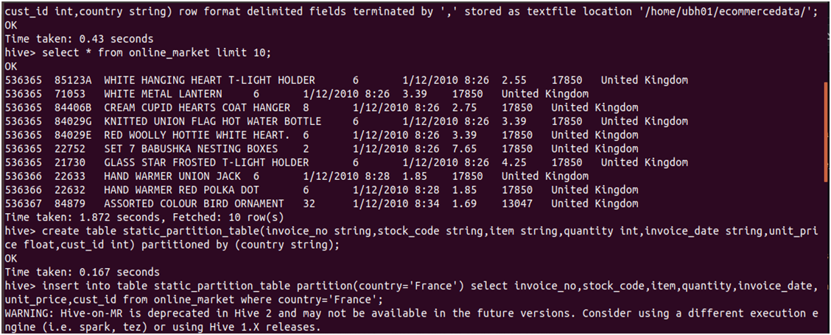
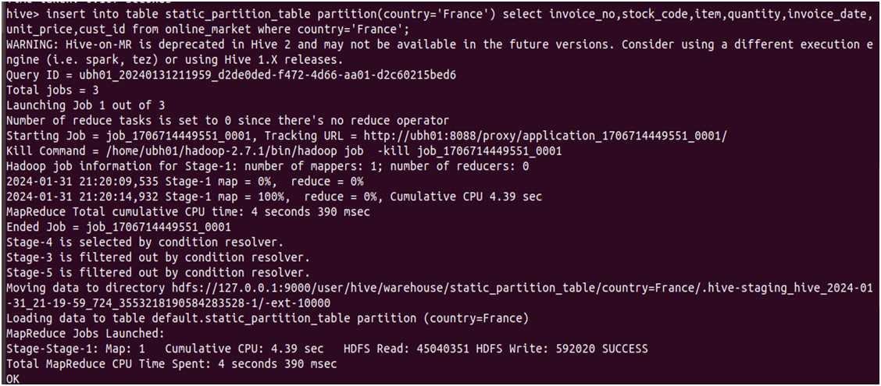
Partitioning – Static Partitioning

Slide 8
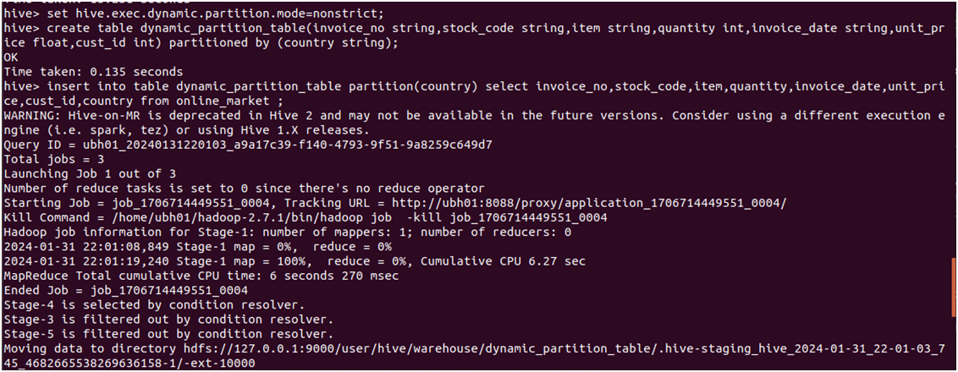
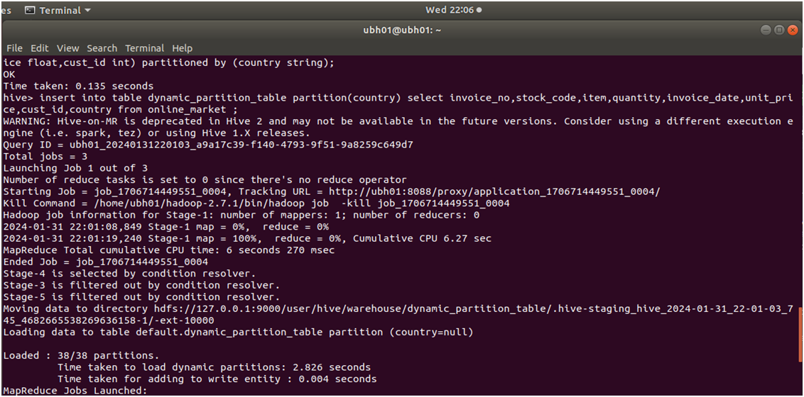
Partitioning – Dynamic Partitioning

Slide 9
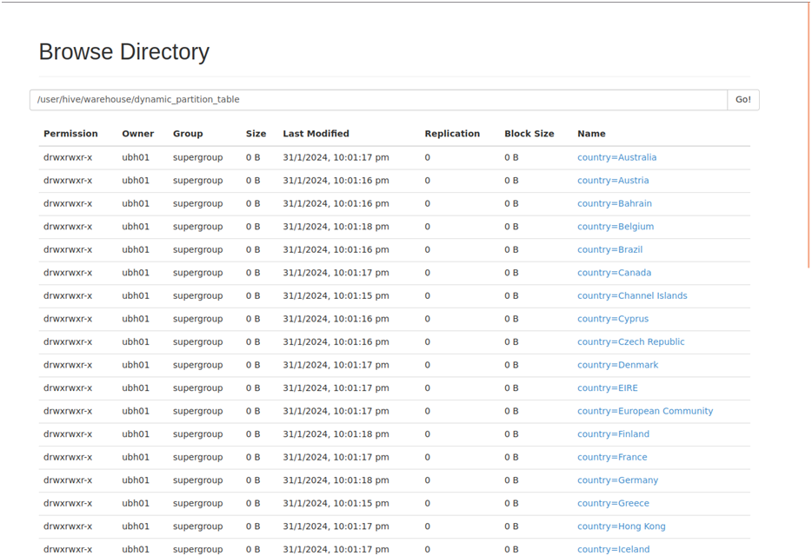
Representation in HDFS

Slide 10
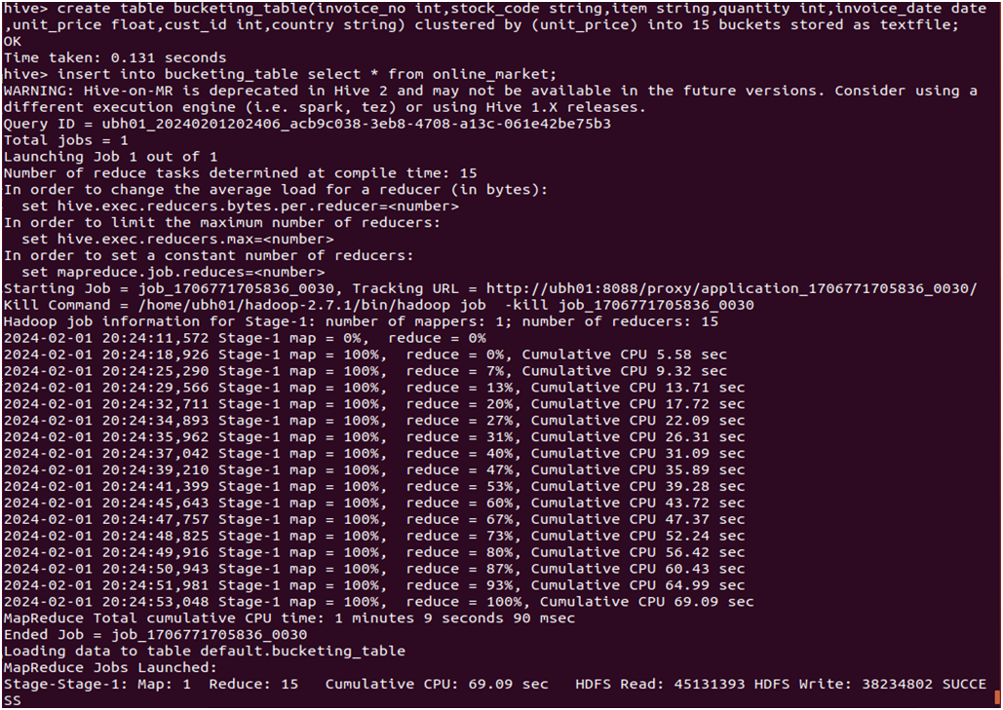
Bucketing – using unit-price column

Slide 11
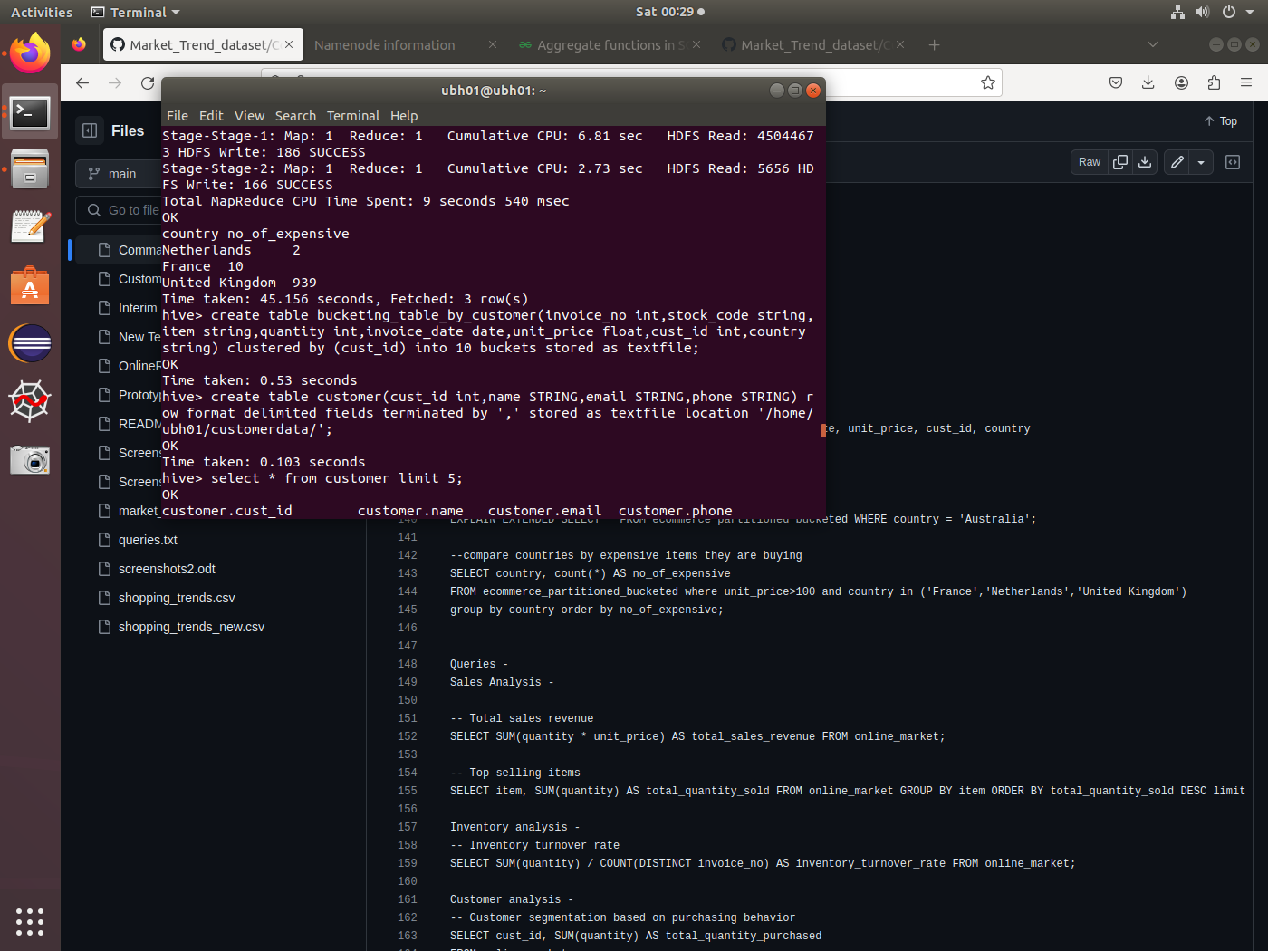
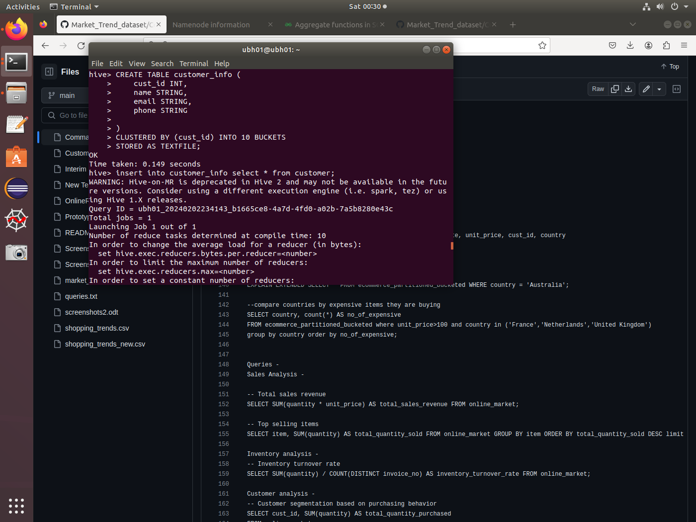
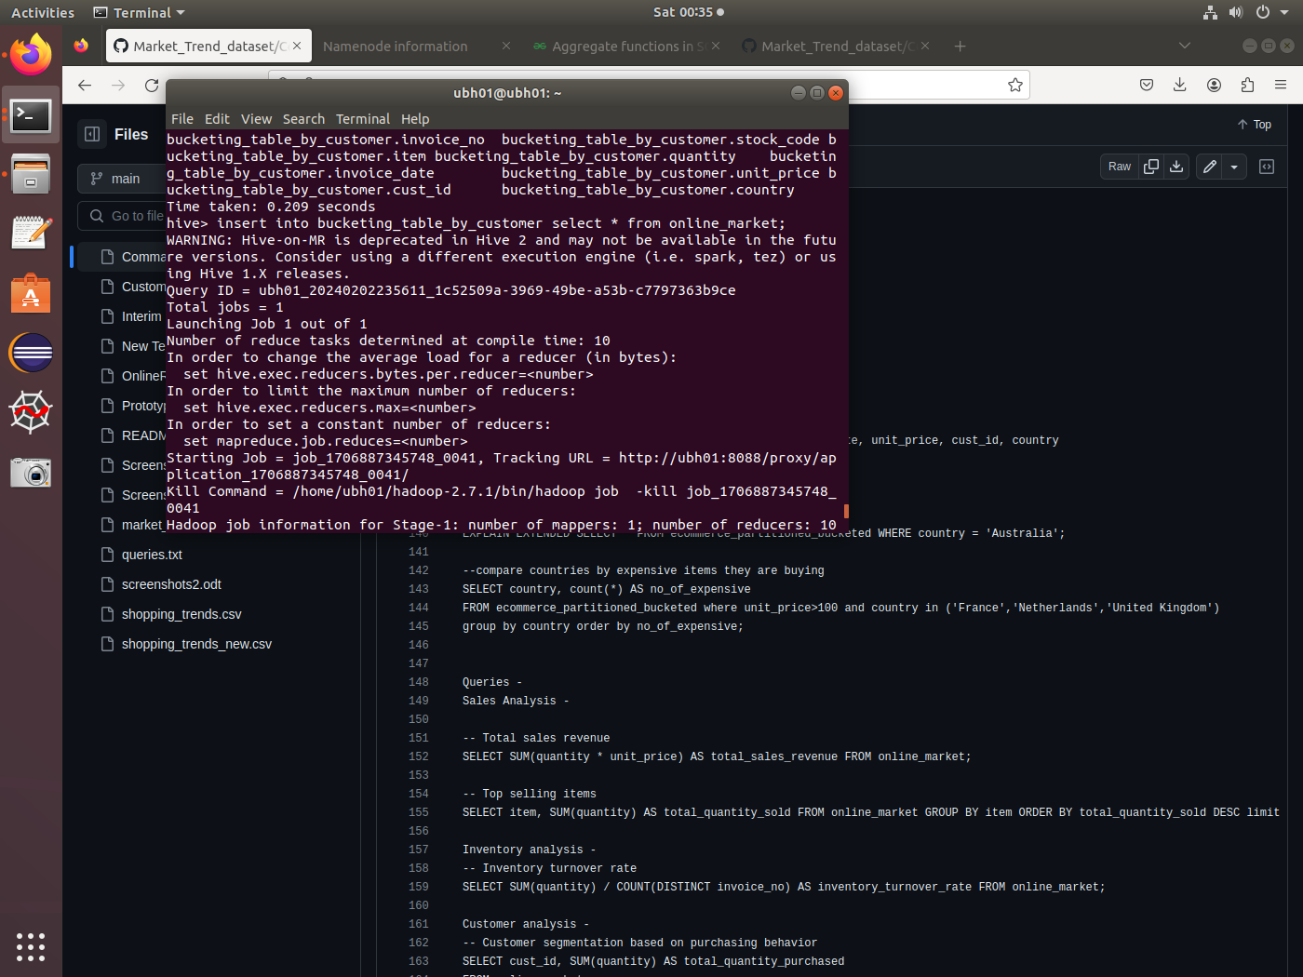
Bucketing-using customer-id column

Slide 12
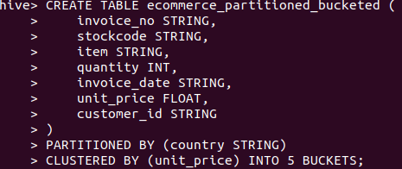
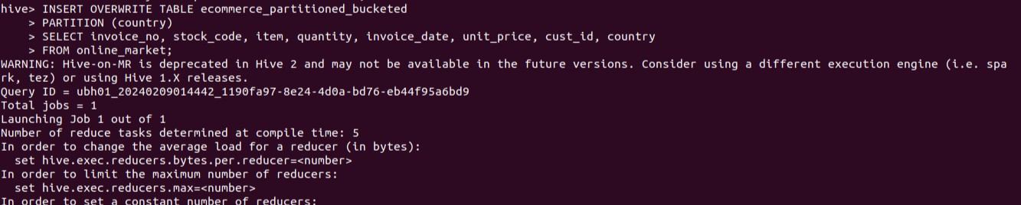
Optimized table using partitioning as well as Bucketing

Slide 13
Solution Workflow
Data Ingestion : Import the Online Retail data from the local system into HDFS.
Data Storage : Store ingested data in HDFS and load it into hive for further processing and analysis.
Optimization using Partitioning and Bucketing : Implement partitioning and bucketing techniques using Apache Hive to optimize data storage and query performance.
Data Analysis & Querying : Develop SQL queries to extract insights from the partitioned , bucketed dataset and original dataset.

Slide 14
Conclusion :- In conclusion, this project has demonstrated the significant performance improvements achievable in Hive by leveraging partitioning and bucketing techniques. Partitioning has streamlined data retrieval by allowing the query engine to skip irrelevant partitions, leading to faster query execution times. Bucketing has helped in evenly distributing data and improving query performance for certain types of queries, especially joins and aggregations. Overall, the combined use of partitioning and bucketing in Hive has showcased substantial improvements in query performance, underscoring their effectiveness in optimizing data retrieval and processing. This project highlights the importance of strategic data organization techniques in maximizing the efficiency of Hive-based data analytics workflows.

Slide 15

Thank you!

